Slide 1
OPERATING SYSTEMS (CS F372) Threads
Barsha Mitra
CSIS Dept., BITS Pilani, Hyderabad Campus

Slide 2
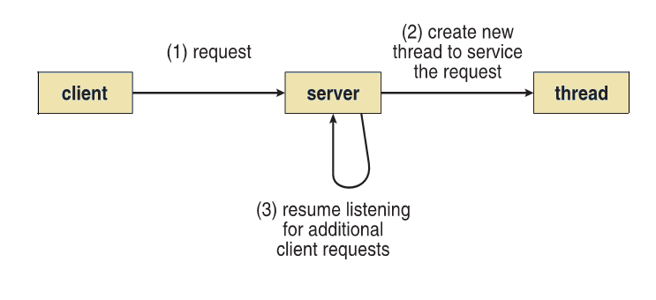
Motivation
Most modern applications are multithreaded
Process creation is heavy-weight while thread creation is light-weight
Increases efficiency
Multithreaded Server Architecture

Slide 3
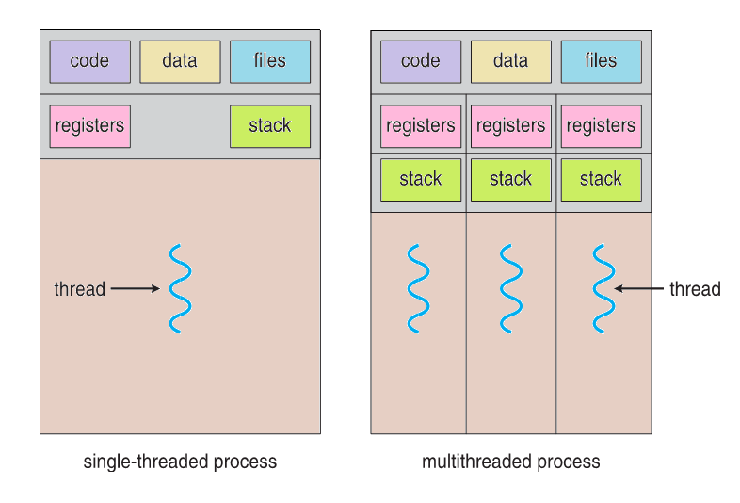
What is Thread?
Basic unit of CPU utilization
Comprises a thread ID, program counter, registers and stack
Shares with other threads belonging to the same program
code section
data section
OS resources like open files

Slide 4
Benefits of Multithreading
Responsiveness – may allow continued execution if part of process is blocked, useful for user interfaces in interactive environments
Resource Sharing – threads share resources of process, easier than shared memory or message passing
Economy – cheaper than process creation, thread switching has lower overhead than context switching
Scalability – multithreaded process can take advantage of multiprocessor architectures

Slide 5
Multicore Programming
Multicore or multiprocessor systems instill programming challenges
Identifying tasks
Balance
Data splitting
Data dependency
Testing and debugging
Parallelism implies a system can perform more than one task simultaneously
Concurrency supports more than one task making progress
Single processor / core system provides concurrency

Slide 6
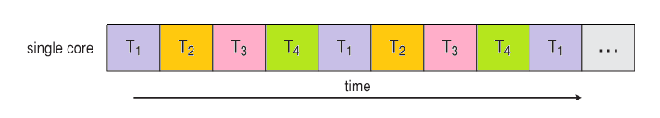
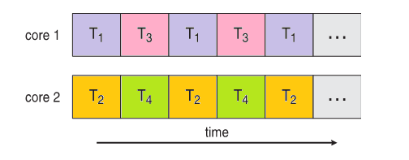
Concurrency vs Parallelism
Concurrent execution on single-core system:
Parallelism on a multi-core system:

Slide 7
Multicore Programming
Types of parallelism
Data parallelism – distributes subsets of the same data across multiple cores, same operation on each subset
Task parallelism – distributes tasks/threads across cores, each thread performing unique operation, threads may be operating on same or different data

Slide 8
Thread Control Block
Thread Identifier: Unique id (tid) is assigned to every new thread
Stack pointer: Points to thread's stack in the process
Program counter of the thread
State of the thread (running, ready, waiting)
Thread's register values
Pointer to the PCB of the process that created it
Pointer(s) to the other thread(s) that were created by this thread
data structure in the kernel which
contains thread-specific information needed to manage it

Slide 9
User Threads
User Threads
(User Mode)
Management done by user-level threads library
No kernel support, kernel does not recognize these threads
All codes & data structures exist in user space
Invoking a func. in the API results in a local func. call in user space & not a system call
Three primary thread libraries:
POSIX Pthreads
Windows threads
Java threads

Slide 10
Kernel Threads
Kernel Threads
(Kernel Mode)
Threads recognized & managed by kernel
System calls are provided to create & manage threads from user space
All codes & data structures exist in kernel space
Invoking a func. in the API results in a system call
virtually all general purpose OS support kernel threads:
Windows
Solaris
Linux
Tru64 UNIX
Mac OS X

Slide 11
Many-to-One Model
Many user-level threads mapped to single kernel thread
Thread management done by thread library in user space
No restriction on the no. of user threads
One thread blocking causes the entire process to block as only one kernel thread is associated with the process
Multiple threads do not run in parallel on muticore system
Few systems currently use this model
Example:
Solaris Green Threads
USER SPACE
KERNEL SPACE

Slide 12
One-to-One Model
Each user-level thread maps to a kernel thread
Creating a user-level thread creates a kernel thread
More concurrency than many-to-one
Number of threads per process sometimes restricted due to overhead
Examples:
Windows
Linux
Solaris 9 and later
USER SPACE
KERNEL SPACE

Slide 13
Many-to-Many Model
Allows many user level threads to be mapped to many (smaller or equal no.) kernel threads
Allows OS to create a sufficient number of kernel threads
When a user thread performs a blocking system call, the kernel can schedule another thread for execution
No restriction on no. of user threads
No. of kernel threads may be application or m/c specific
USER SPACE
KERNEL SPACE

Slide 14
Two-Level Model
Similar to M:M, except that it allows a user thread to be bound to kernel thread
Examples
IRIX
HP-UX
Tru64 UNIX
Solaris 8 and earlier
USER SPACE
KERNEL SPACE

Slide 15
Thread Libraries
Thread library provides programmer with API for creating and managing threads
Two primary ways of implementing
Library entirely in user space
code & data structures in user space
no kernel support
library func. invocation is a not a system call
Kernel-level library supported by the OS
code & data structures in kernel space
API func. call is a system call

Slide 16
Pthreads
May be provided either as user-level or kernel-level
A POSIX standard (IEEE 1003.1c) API for thread creation and synchronization
Specification, not implementation
API specifies behavior of the thread library, implementation is up to development of the library
Common in UNIX operating systems (Solaris, Linux, Mac OS X)

Slide 17
Pthreads
pthread_t
pthread_attr_t
int pthread_attr_init (pthread_attr_t *attr);
int pthread_create (pthread_t *tid, const pthread_attr_t *attr, void *(*start_routine) (void *), void *arg);

Slide 18
Pthreads
int pthread_equal (pthread_t tid1, pthread_t tid2);
void pthread_exit (void *ptr);
int pthread_join (pthread_t tid, void **retval);
pid_t gettid ( );
pthread_t pthread_self ( );

Slide 19
#include <pthread.h>
#include <stdio.h>
int sum; /* this data is shared by the threads */
void *runner(void *param); /* threads call this function */
int main(int argc, char *argv[])
{
pthread_t tid; /* the thread identifier */
pthread_attr_t attr; /* set of thread attributes */
if (argc != 2) {
fprintf(stderr, “No argument\n");
return -1; }
if (atoi(argv[1]) < 0) {
fprintf(stderr,"%d must be >= 0",atoi(argv[1]));
return -1; }
pthread_attr_init(&attr); /* set the default attributes */
pthread_create(&tid, &attr, runner, argv[1]); /* create the thread */
pthread_join(tid, NULL); /* main thread waits for the thread to exit */
printf("sum = %d\n", sum); /*main thread resumes execution*/
}
Pthreads Example
/* The thread will begin control in this function */
void *runner(void *param)
{
int i, upper = atoi(param);
sum = 0;
for (i = 1; i <= upper; i++)
sum += i;
pthread_exit(0);
}
synchronous threading

Slide 20
Pthreads Example
#define NUM THREADS 10
/* an array of threads to be joined upon */
pthread_t workers[NUM THREADS];
for (int i = 0; i < NUM THREADS; i++)
pthread_join(workers[i], NULL);
JOINING 10 THREADS

Slide 21
Threading Issues
fork() and exec() system calls
Signal handling
Cancellation of target thread
Thread-local storage

Slide 22
fork() and exec()
If one thread in a program calls fork(), does the new process duplicate all threads, or is the new process single-threaded?
Two versions of fork(), one that duplicates all threads and another that duplicates only the thread that invoked the fork() system call
exec() call works in the same way
if a thread invokes the exec(), the program specified in the parameter to exec() will replace the entire process—including all threads
If exec() is called immediately after forking, then duplicating all threads is unnecessary, as the program specified in the parameters to exec() will replace the process
duplicating only the calling thread is appropriate
If the separate process does not call exec() after forking, the separate process should duplicate all threads
https://manpages.ubuntu.com/manpages/focal/en/man3/pthread_atfork.3.html

Slide 23
Signal Handling
Signals are used to notify a process that a particular event has occurred
Signal is delivered to a process
When delivered, signal handler is used to process signals
Synchronous signals
illegal memory access, div. by 0
delivered to the same process that performed the operation generating the signal
Asynchronous signals
generated by an event external to a running process
the running process receives the signal asynchronously
Ctrl + C, timer expiration

Slide 24
Signal Handling
Signal is handled by:
default handler
user-defined handler
Every signal has default handler that kernel runs when handling signal
User-defined signal handler can override default signal handler
Some signals can be ignored, others are handled by terminating the process
For single-threaded process, signal is delivered to process

Slide 25
Signal Handling
Where should a signal be delivered for multi-threaded process?
How to deliver a signal depends on the type of signal generated
synchronous signals → thread causing the signal and not to other threads in the process
some asynchronous signals (<Ctrl + C>) → to all threads
Most multithreaded versions of UNIX allow a thread to specify which signals it will accept and which it will block
Asynchronous signal may be delivered only to those threads that are not blocking it

Slide 26
Thread Cancellation
Terminating a thread before it has finished
Thread to be canceled is target thread
Two approaches:
Asynchronous cancellation – one thread terminates the target thread immediately
Deferred cancellation allows the target thread to periodically check if it should be cancelled, target thread can terminate itself in orderly fashion
What about freeing resources??
pthread_t tid;
/* create the thread */
pthread_create(&tid, &attr, worker, NULL);
. . .
/* cancel the thread */
pthread_cancel(tid);

Slide 27
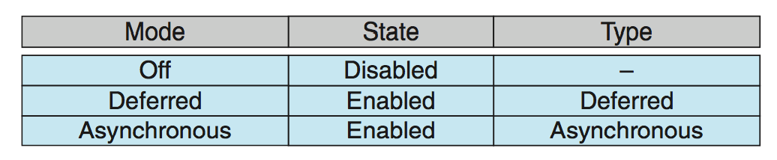
Thread Cancellation
Invoking thread cancellation requests cancellation
Actual cancellation depends on how the target thread is set up to handle the request
default type
Deferred
Cancellation only occurs when thread reaches cancellation point
Establish cancellation point by calling pthread_testcancel()
If cancellation request is pending, cleanup handler is invoked to release acquired resources

Slide 28
Thread-Local Storage
Thread-local storage (TLS) allows each thread to have its own copy of data
TLS data are unique to each thread
Different from local variables
Local variables visible only during single function invocation
TLS visible across function invocations
Declaration

Slide 29
Thank You

